Slide 1



Slide 3
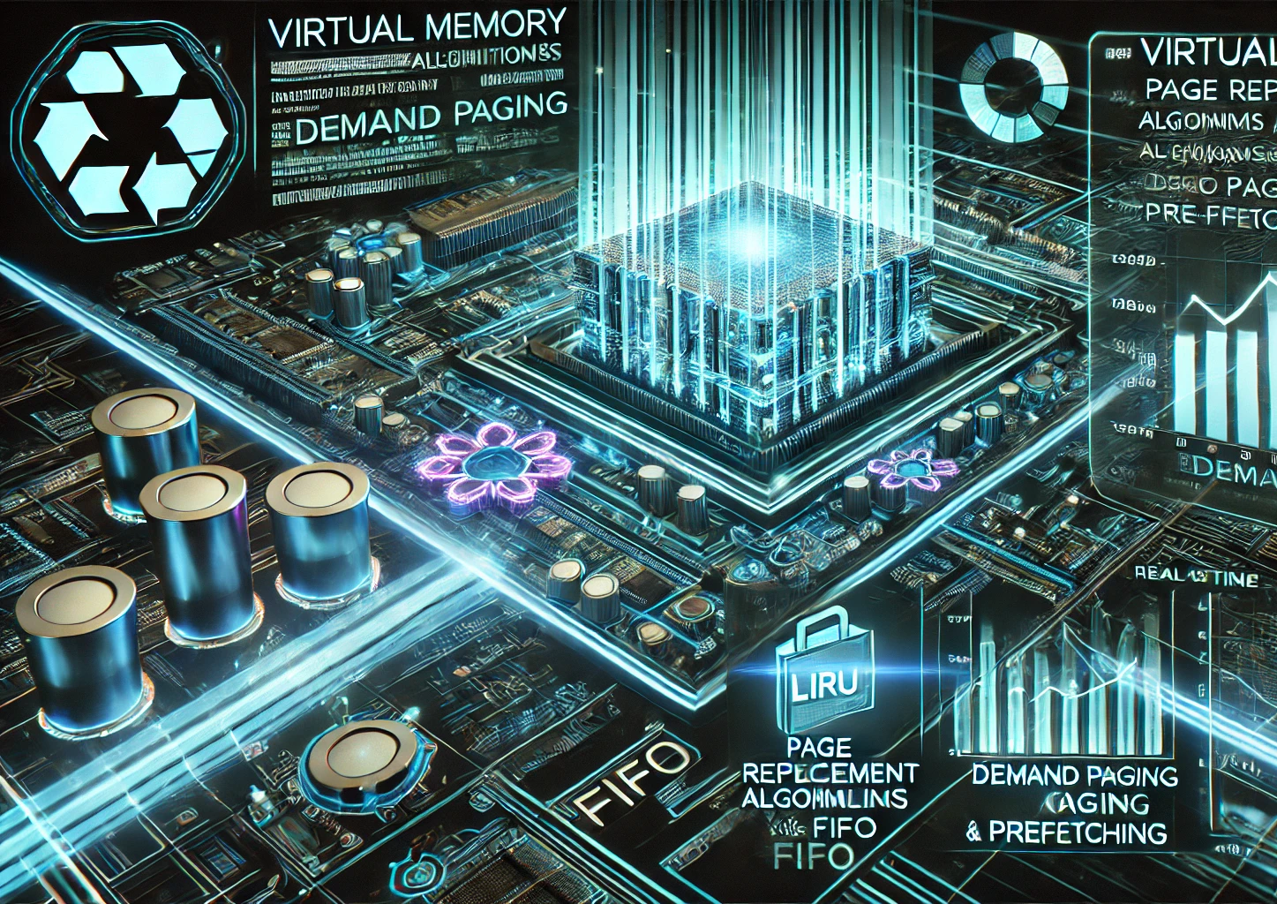
Virtual Memory Optimization for High Performance Systems
SAI RAMANA D
192325158L
CSA0403
27-02-2025

Slide 4
AGENDA
1
The Need for
Virtual Memory Optimization
2
CNC CONTROL SYSTEM
3
ELEMENTS OF CNC MACHINE
4
CNC OPERATING MODES
5
CNC PROGRAMMING

Slide 5
AGENDA
1
The Need for
Virtual Memory Optimization
2
Challenges in High Memory Usage
3
ELEMENTS OF CNC MACHINE
4
CNC OPERATING MODES
5
CNC PROGRAMMING

Slide 6
AGENDA
1
The Need for
Virtual Memory Optimization
2
Challenges in High Memory Usage
3
Techniques for Virtual Memory Optimization
4
CNC OPERATING MODES
5
CNC PROGRAMMING

Slide 7
AGENDA
1
The Need for
Virtual Memory Optimization
2
Challenges in High Memory Usage
3
Techniques for Virtual Memory Optimization
4
Simulation and Analysis
5
CNC PROGRAMMING

Slide 8
AGENDA
1
The Need for
Virtual Memory Optimization
2
Challenges in High Memory Usage
3
Techniques for Virtual Memory Optimization
4
Simulation and Analysis
5
Results
and
Future
Work

Slide 9
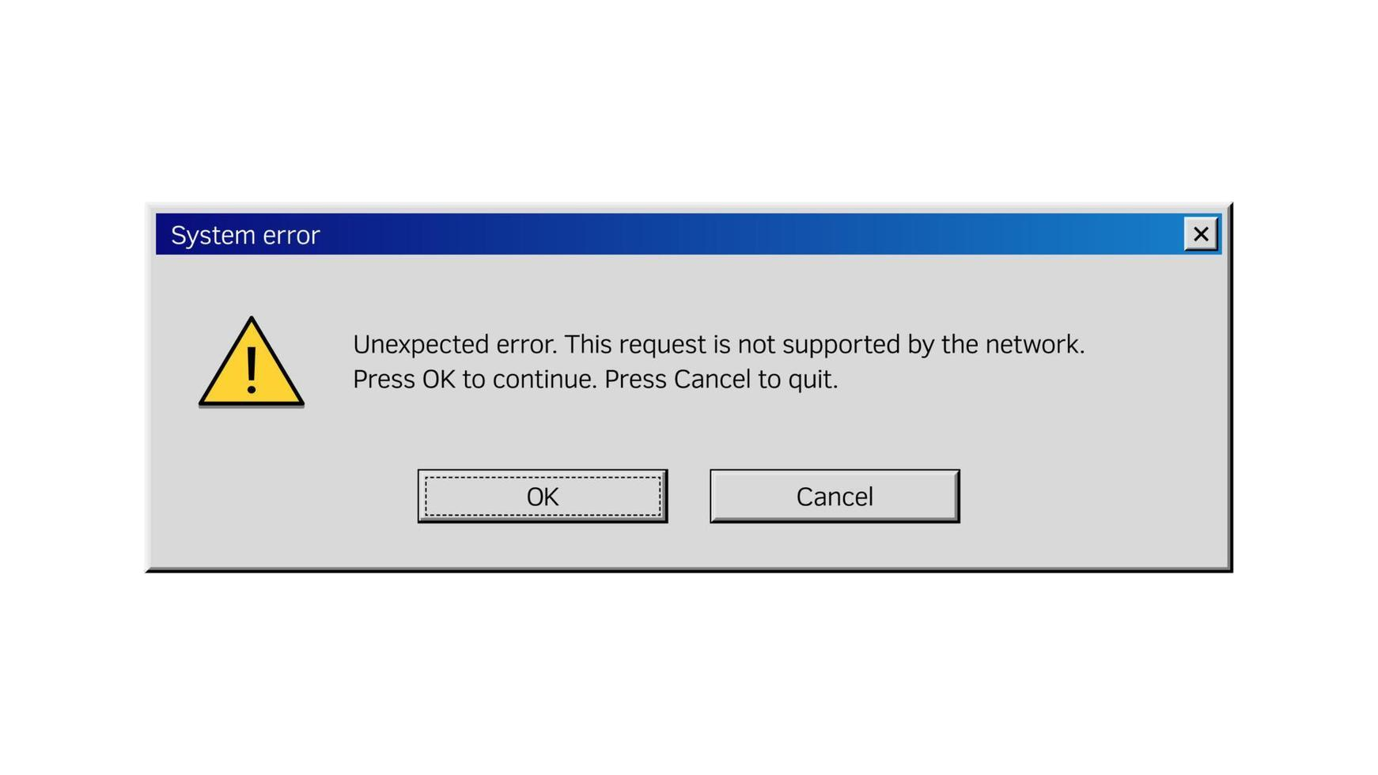
What is Virtual Memory?
Why is it important in modern computing?
How does it help manage high-memory workloads?
Overview of project objectives.

Slide 10
Problem Statement
High-memory workloads cause performance bottlenecks.
Issues like page faults, memory thrashing, and inefficient allocation.
Need for optimized memory management techniques.
Goal: Improve system performance using advanced techniques.

Slide 11
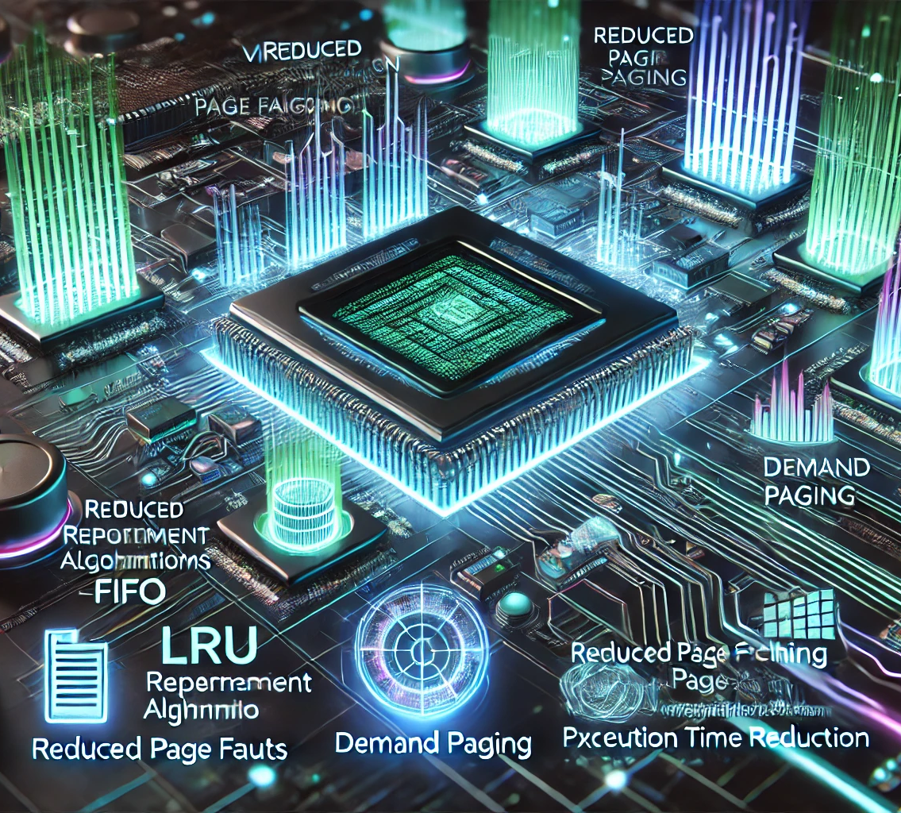
Introduction: Virtual Memory Optimization for High-Performance Systems
Virtual memory is a critical component of modern computing, enabling systems to efficiently manage limited physical memory by utilizing disk storage. However, high memory usage scenarios often lead to performance bottlenecks, such as increased page faults, memory thrashing, and inefficient resource utilization.
This project focuses on optimizing virtual memory management techniques to enhance system performance under high memory demands. By leveraging advanced page replacement algorithms (e.g., LRU, FIFO), demand paging, and prefetching strategies, we aim to:
Reduce page fault rates,
Improve memory utilization efficiency, and
Minimize execution time.
Through simulated workloads and varied memory configurations (4 GB, 8 GB, 16 GB), we will evaluate and refine these techniques to deliver actionable insights for high-performance systems.

Slide 12
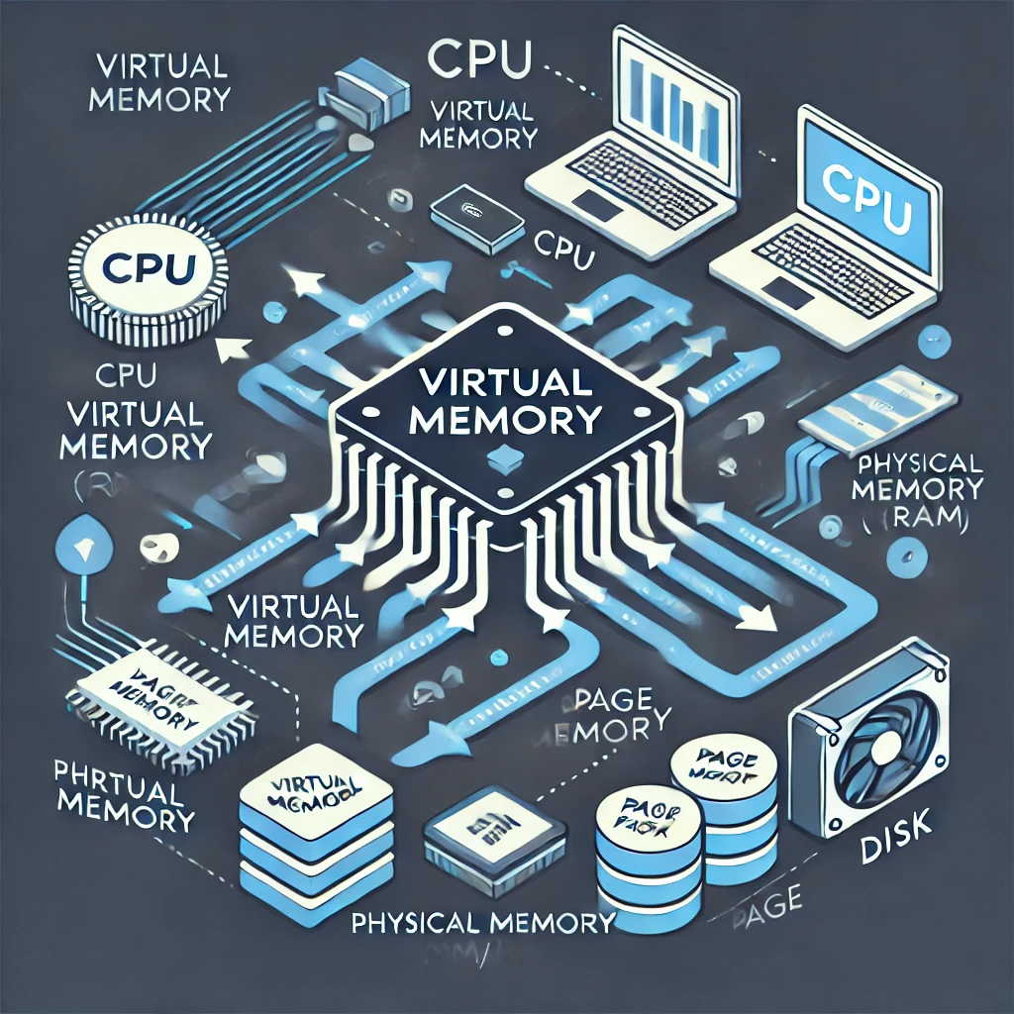
Virtual Memory Basics
What is Virtual Memory?
A memory management technique that uses both RAM and disk storage to simulate larger memory space.
Key Concepts:
Paging: Dividing memory into fixed-size blocks (pages).
Page Tables: Mapping virtual addresses to physical addresses.
Swapping: Moving pages between RAM and disk.

Slide 13
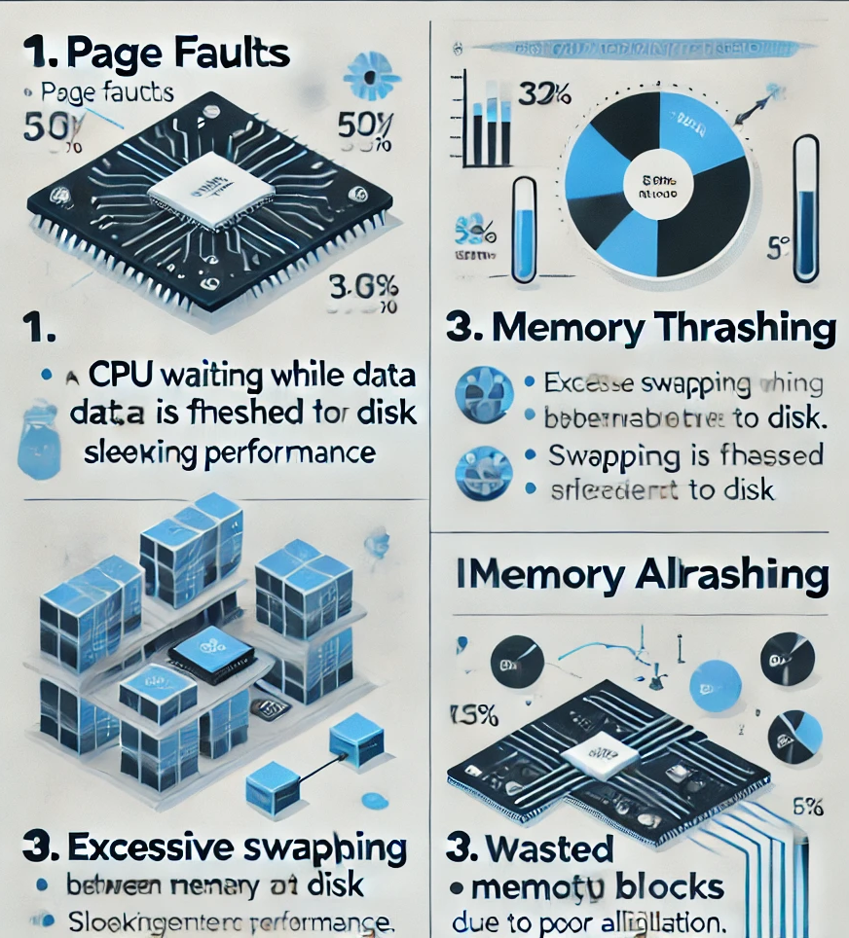
Challenges in High Memory Usage
Page Faults: Occur when a required page is not in RAM, causing delays as it is fetched from disk.
Memory Thrashing: Excessive swapping due to insufficient memory, leading to performance degradation.
Inefficient Allocation: Poor memory utilization, resulting in wasted resources.

Slide 14
Objectives:
The primary goal is to optimize virtual memory management by:
Reducing Page Fault Rate: Minimize the frequency of page faults.
Improving Memory Utilization Efficiency: Ensure optimal use of available memory.
Minimizing Execution Time: Speed up system performance under high memory workloads.

Slide 15
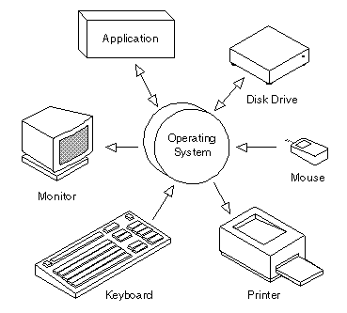
Scientific Basis and Controversies in Astrology
Astrology’s position in scientific discourse is controversial, as it operates on assumptions that differ from empirical sciences. However, interdisciplinary research has seen psychologists and social scientists explore correlations between personality traits and astrological aspects, especially with the resurgence of personality typologies in psychological studies. Springer and Scopus-indexed psychology journals feature analyses of the psychological effects of astrological belief, with some suggesting that the descriptive power of astrology may provide a framework for self-reflection and personal growth. Conversely, critiques of astrology, often found in IEEE journals on scientific methodology, argue that its lack of empirical verifiability challenges its scientific status. Researchers in these papers assess astrology’s impact on human behavior and belief systems, exploring why, despite criticisms, it persists across cultures. This body of research allows for a balanced view on astrology’s place within society and suggests that while it may lack empirical rigor, its psychological impact is significant.
Key Techniques Overview
Page Replacement Algorithms: Decide which pages to replace when memory is full (e.g., LRU, FIFO).
Demand Paging: Load pages into memory only when they are needed.
Prefetching: Predict and load pages into memory before they are required.

Slide 16

Page Replacement Algorithms
LRU (Least Recently Used):
Replaces the page that has not been used for the longest time.
Advantage: Effective for workloads with temporal locality.
FIFO (First In, First Out):
Replaces the oldest page in memory.
Advantage: Simple to implement but may not always be efficient.

Slide 17

Demand Paging
Concept: Pages are loaded into memory only when they are accessed, reducing initial memory usage.
Advantages:
Saves memory by loading only necessary pages.
Improves system responsiveness.
Challenges:
Can lead to frequent page faults if not managed properly.

Slide 18
Simulation Setup
Workloads: Simulated high memory usage scenarios.
Memory Configurations: Tested with 4 GB, 8 GB, and 16 GB memory setups.
Metrics: Page fault rate, memory utilization efficiency, execution time.

Slide 19

Conclusion
Virtual memory optimization is crucial for high-performance systems.
Techniques like LRU, demand paging, and prefetching significantly improve performance.
Future work can explore adaptive algorithms and machine learning for better predictions.

Slide 20


